Slide 1

Unlocking Customer Insights
Leveraging data for strategic business growth.

Slide 2
Presentation Outline
01
02
Business Problem
EDA (Exploratory Data Analysis)
Defining the core challenges we aim to solve.
Uncovering patterns and insights from raw data.
03
04
Trends and Projections
Data-Driven Recommendation
Forecasting future outcomes based on historical data.
Proposing strategic actions supported by evidence.

Slide 3

The Business Problem
Understanding Customer Behavior
Optimizing Strategies
How can we use data to improve marketing and product offerings?
How can we better understand our customers' purchasing habits?
Driving Growth
How can these insights lead to increased revenue and loyalty?

Slide 4

Overview & Dataset Summary
Understanding the dataset's structure, size, and key variables is crucial for effective analysis.
01
02
Data Organization
Dataset Overview
Datasets are organized into logical structures, often separating raw imports from cleaned and prepared versions to ensure data integrity and analytical readiness.
A preliminary inspection of the dataset's columns and a sample of its rows helps in identifying key variables, data types, and overall structure.
SELECT * FROM customer_behavior_clean LIMIT 10;
CREATE DATABASE datacleaning;
03
Analysis Preparation
Creating optimized views facilitates reporting in tools like Power BI, streamlining access to key variables and insights derived from the dataset.
CREATE VIEW vw_customer_behavior AS ...

Slide 5
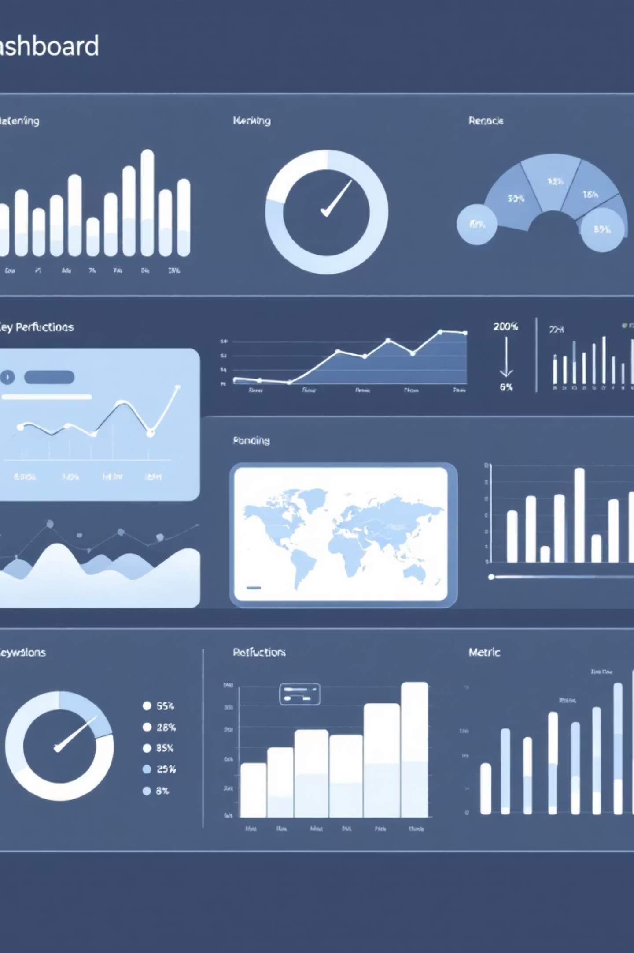
Key Variables Distribution
10K+
$150
4.2
Customer Count
Average Purchase
Average Review Rating
Total unique customer IDs in the dataset, indicating the scale of our customer base.
Average value of transactions, representing a central tendency for spending habits.
Mean customer satisfaction score, reflecting the overall sentiment towards products/services.
These summaries highlight the characteristics and distribution of key variables within the dataset.

Slide 6
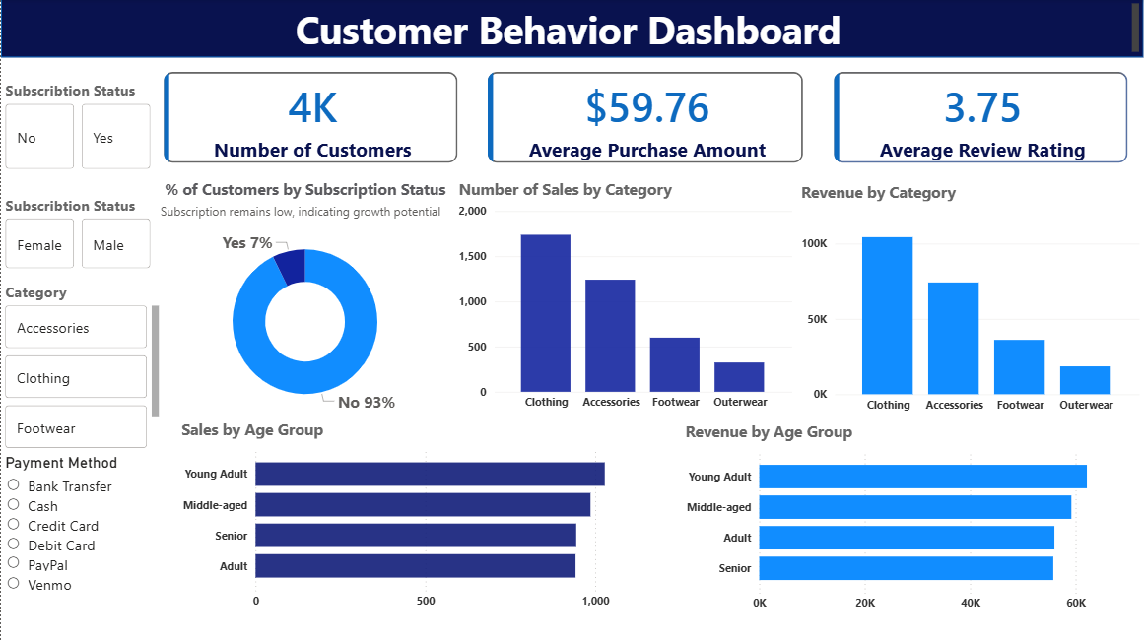
Key Variables Distribution: Customer Behavior Patterns

Slide 7
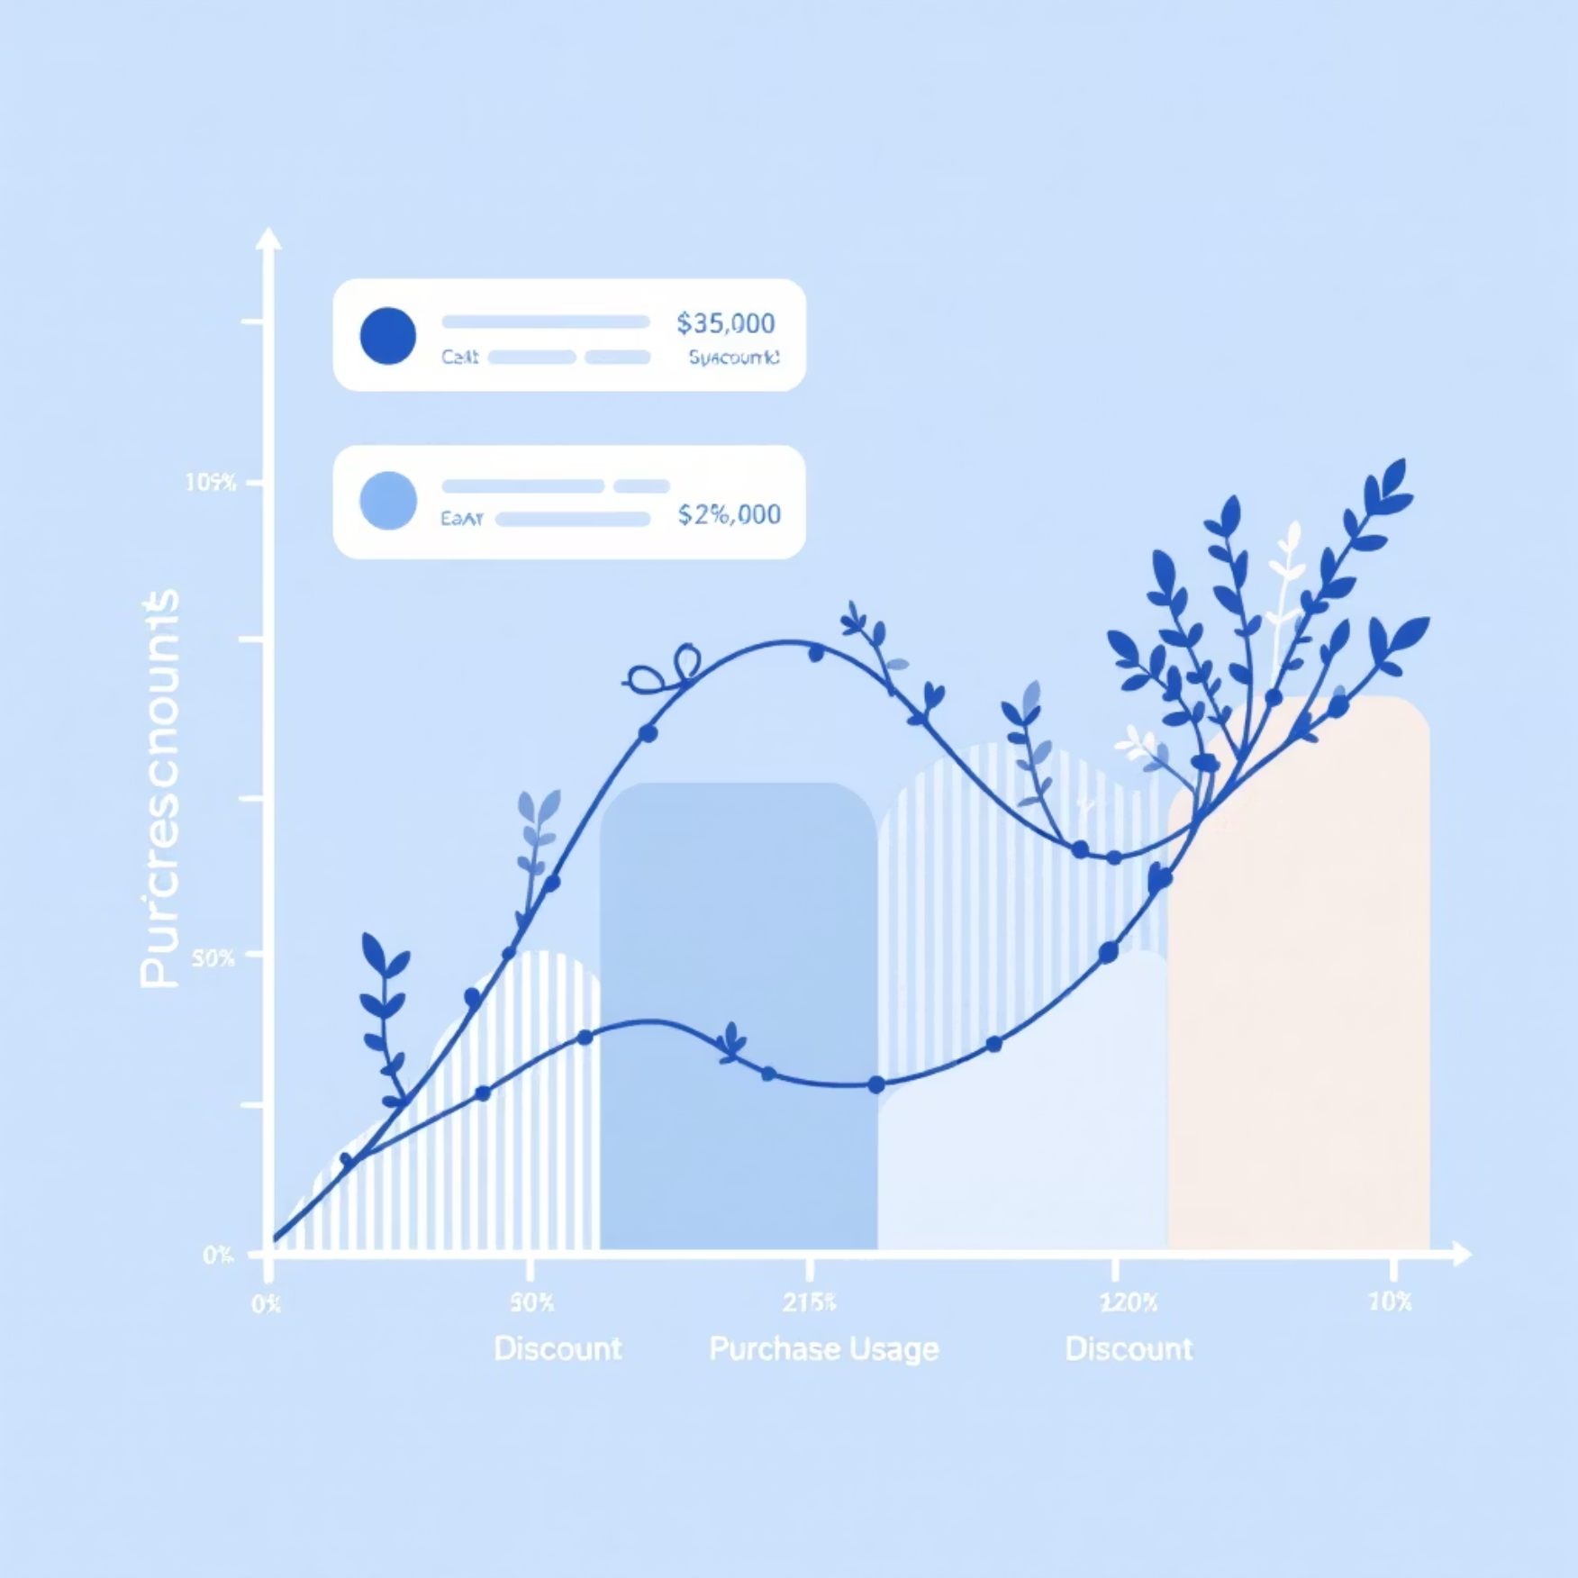
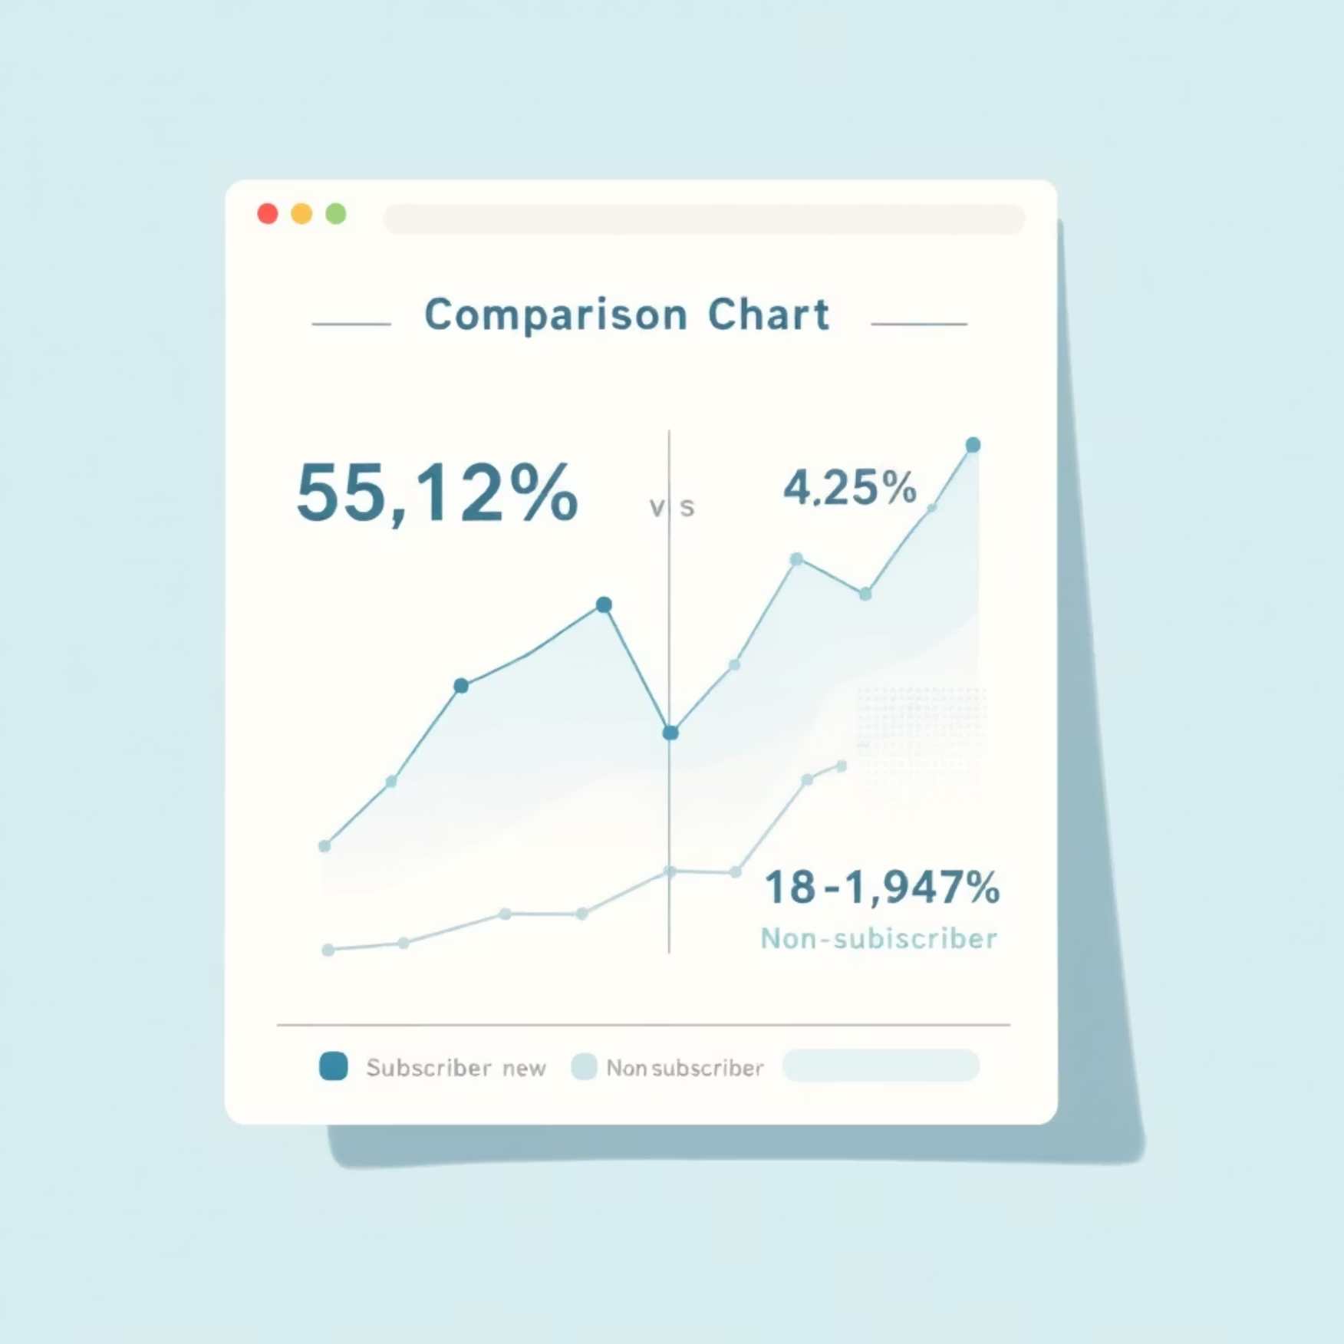
Key Variables Distribution: Discounts & Subscriptions
Discount Impact
Subscriber Spending
Customers using discounts but spending above average.
Avg. spend and total revenue for subscribers vs. non-subscribers.
SELECT COUNT(DISTINCT customer_id) FROM customer_behavior_clean WHERE discount_applied = 'Yes' AND purchase_amount >= (SELECT AVG(purchase_amount) FROM customer_behavior_clean);
SELECT subscription_status, AVG(purchase_amount), SUM(purchase_amount) FROM customer_behavior_clean GROUP BY subscription_status;

Slide 8

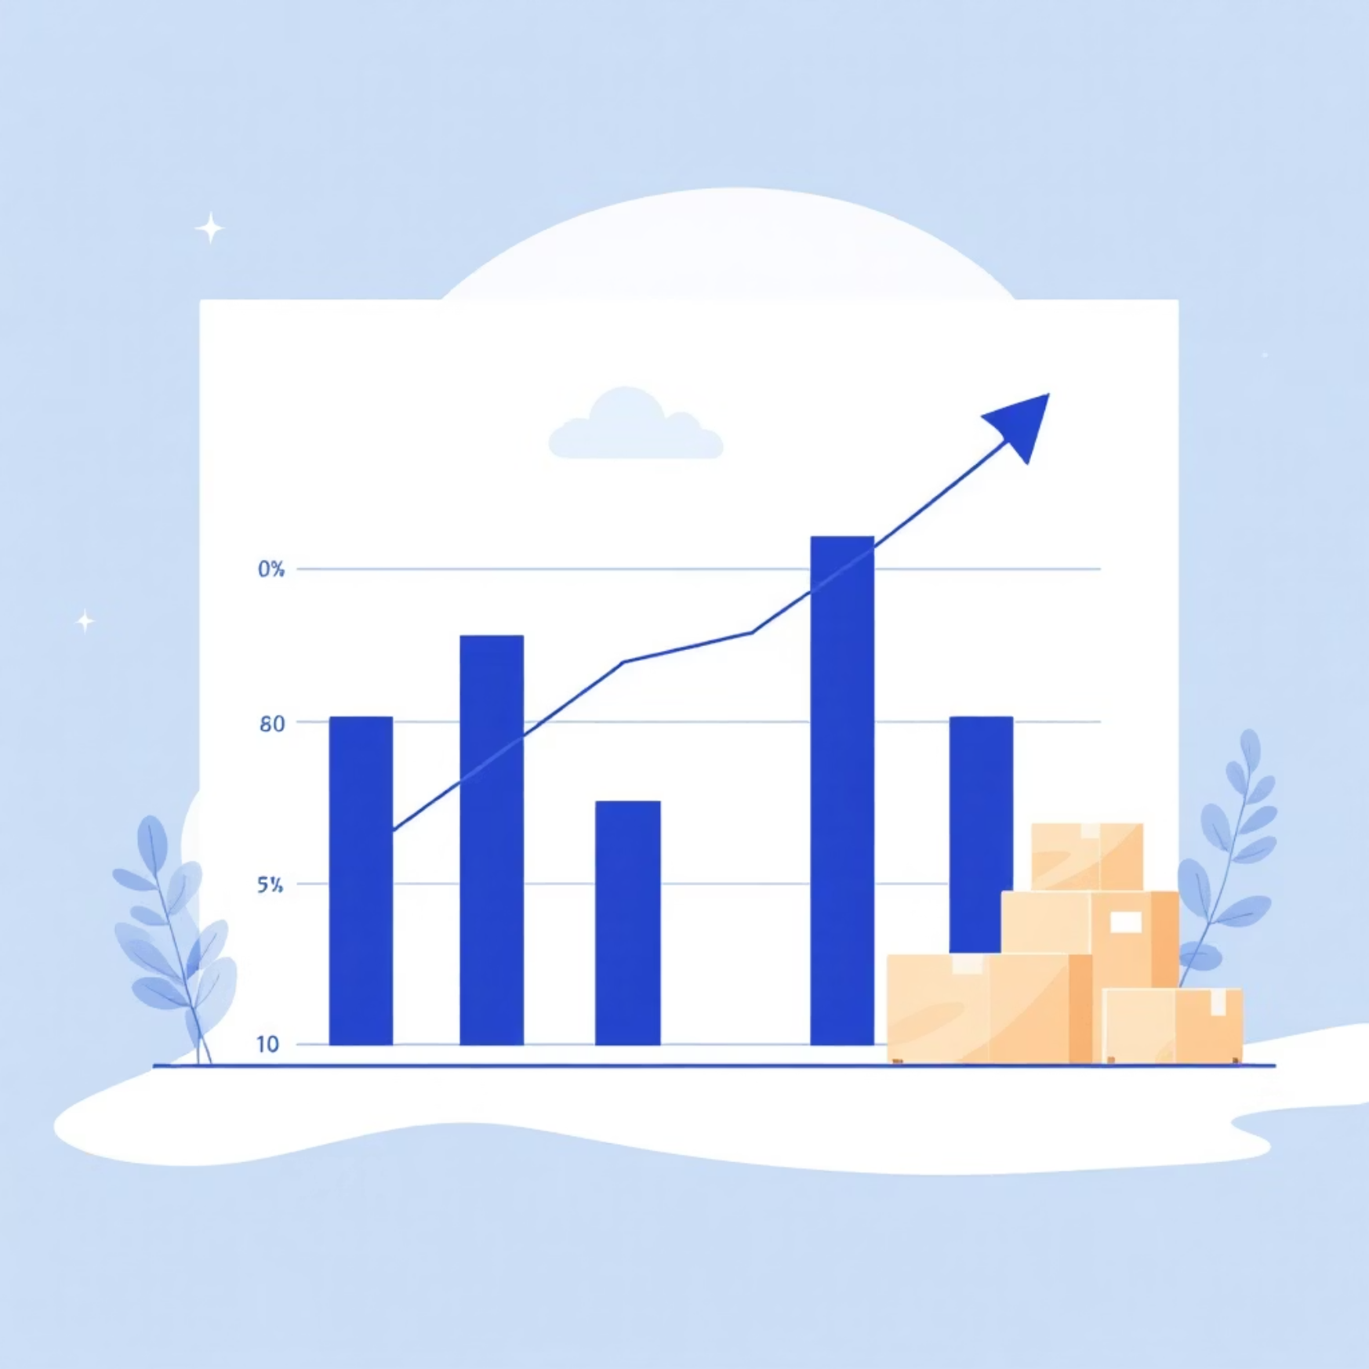
Key Variables Distribution: Product & Shipping Analysis
Top Reviewed Products
Shipping Type Comparison
Top 5 products with highest average review rating.
Average purchase amounts for Standard vs. Express shipping.
SELECT item_purchased, AVG(review_rating) FROM customer_behavior_clean GROUP BY item_purchased ORDER BY avg_review_rating DESC LIMIT 5;
SELECT shipping_type, AVG(purchase_amount) FROM customer_behavior_clean GROUP BY shipping_type;

Slide 9
Data-Driven Recommendations
1
Strengthen Subscription Programs
Incentivize high-frequency customers to subscribe.
2
Focus Marketing on High-Value Age Groups
Tailor campaigns for top-performing segments.
3
Optimize Product Category Strategy
Prioritize top-performing categories; reassess underperforming ones.
4
Use Discounts Strategically
Targeted discounts for high-value customers.
5
Leverage Customer Reviews
Encourage reviews and address feedback promptly.
6
Strengthen Retention of Loyal Customers
Implement loyalty programs for repeat buyers.

